Slide 1
MS and COVID 19- updates
Dr H. Ayromlou
Professor of Neurology
Tabriz University of Medical Sciences

Slide 2
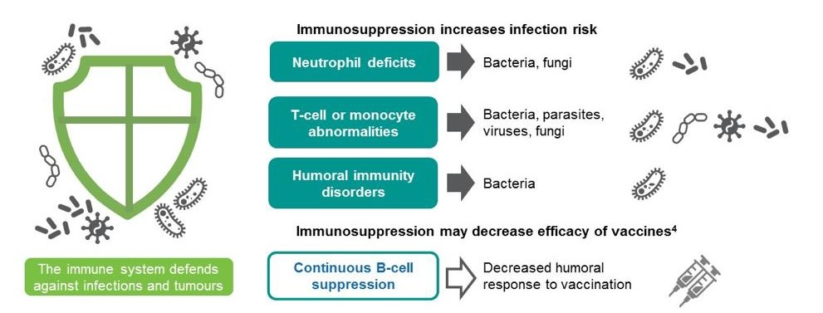
Immunosuppression and Infection Risk
aaaaaaaa

Slide 3
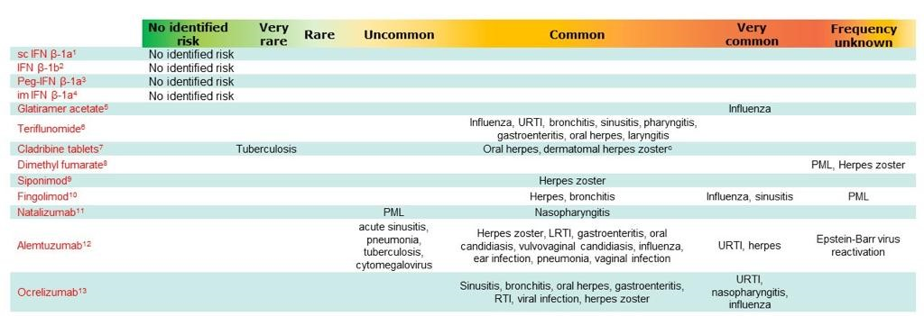
DMTs and Viral Infection Risk
aaaaaaaa
Notes:
ªSlide prepared Apr 2020; EU labels accessed Apr 2020; ^{b}Frequency: Very common (≥1/10), Common (≥1/100 to <1/10), Uncommon (≥1/1,000 to <1/100),), Very rare (<1/10,000); ^{c}The incidence of herpes zoster was higher during the period of grade 3 or 4 lymphopenia (<500 to 200 cells/mm³ or <200 cells/mm³) compared to the time when the patients were not experiencing grade 3 or 4 lymphopenia. Rare (≥1/10,000 to <1/1,000

Slide 4
Potential effects of DMTs on the immune system
DMT | Effect on immune system | Time taken for immune system recovery to normal range after DMT cessation
Interferons | Augments adaptive/acquired immune responses; direct inhibition of viral replication¹ | N/A
Dimethyl fumarate | Lymphocyte depletion
Fingolimod | Lymphocyte sequestration
Natalizumabª | Lymphocyte sequestration
Ocrelizumab | B-cell depletion
Alemtuzumab^{b} | Transient lymphocyte depletion
Cladribine Tablets | Transient lymphocyte depletion
ALC: 4 weeks²
ALC: ≤8 weeks³
All affected immune cells: ≤16 weeks⁴
B cells: 72 weeks⁵
B cells: <3 months⁶
CD4+ T cells: ~35 months⁷
ALC: 30 weeks⁸
CD4+ T cells:^{c} 70 weeks⁸
B cells: 30 weeks⁸
0
25
50
75
100
125
150
Weeks
ªTysabri®; ^{b}Lemtrada®; ^{C}Median CD8+ T cells did not drop below lower limit of normal
ALC, absolute lymphocyte count; DMT, disease-modifying drug 1. Borden E, et al. Nat Rev Drug Discov. 2007; 6(12): 975–990. 2. Dimethyl fumarate US PI, December 2017; 3. Fingolimod EU SmPC, April 2018; 4. Natalizumab EU SmPC, April 2018; 5. Ocrelizumab EU SmPC, March 2018; 6. Baker D et al. Neurol Neuroimmunol Neuroinflamm 2017;4:e360; 7. Baker D et al. JAMA Neurol 2017;74:961–9; 8. Sørensen PS et al. ACTRIMS 2018 [P084]

Slide 5
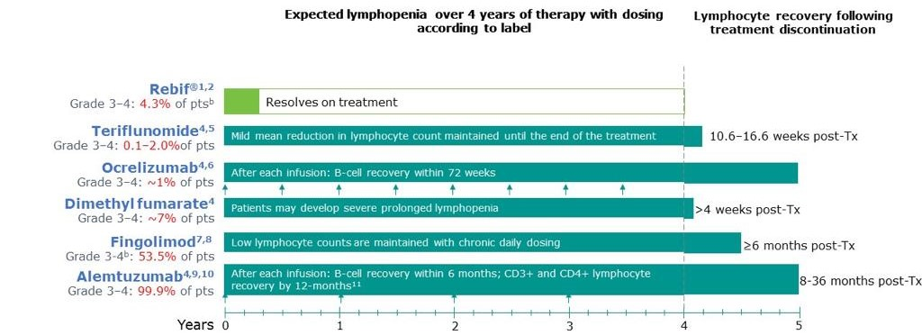
Recovery Time from Grade 3&4 Lymphopenia

Slide 6
Recommendations for switching between DMTs

Slide 7
Rebound After DMTs Discontinuation

Slide 8
Severe Covid 19 Infection in MS Patients (Somani et al Lancet 2020)

Slide 9
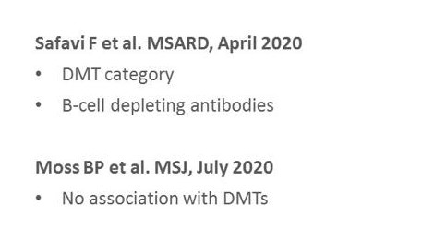
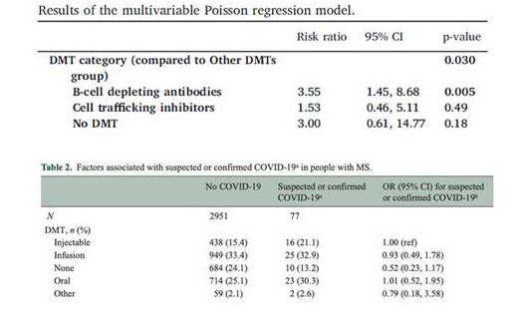
DMTs and Susceptibility to Covid 19 Infection

Slide 10
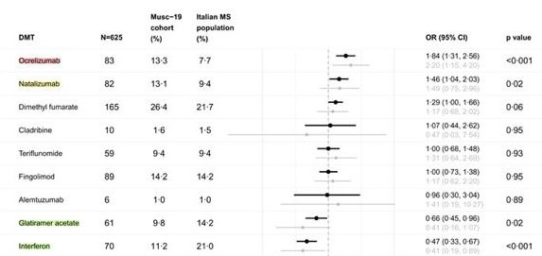
DMTs and Susceptibility to Covid 19 Infection

Slide 11
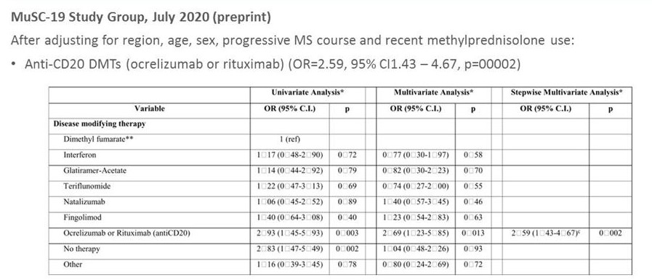
Risk of Severe Covid 19 Infection and DMTs

Slide 12
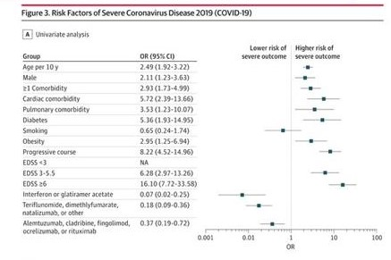
Risk of Severe Covid 19 Infection in MS Patients

Slide 13
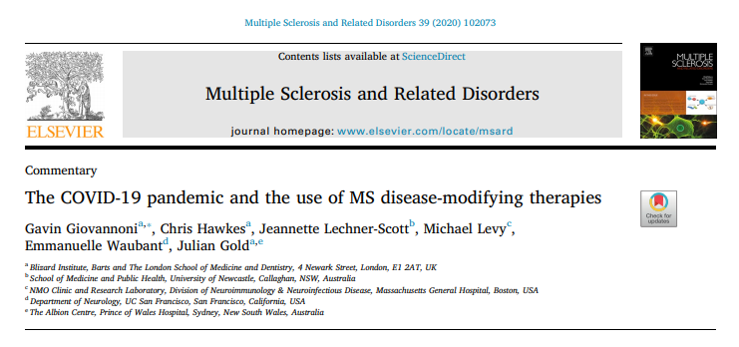

Slide 14
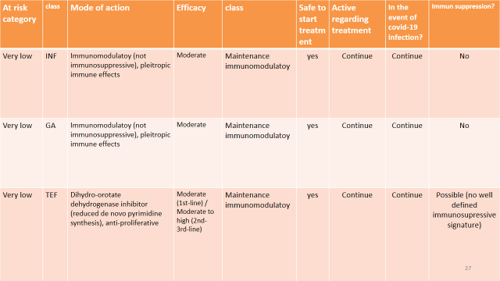

Slide 15
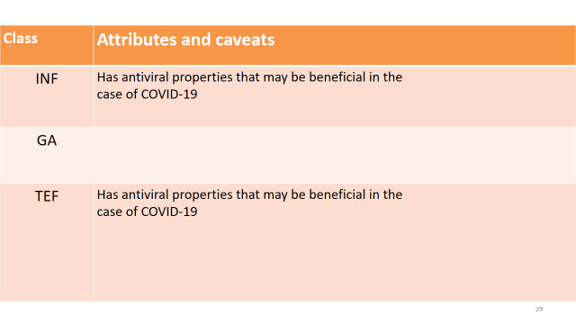

Slide 16
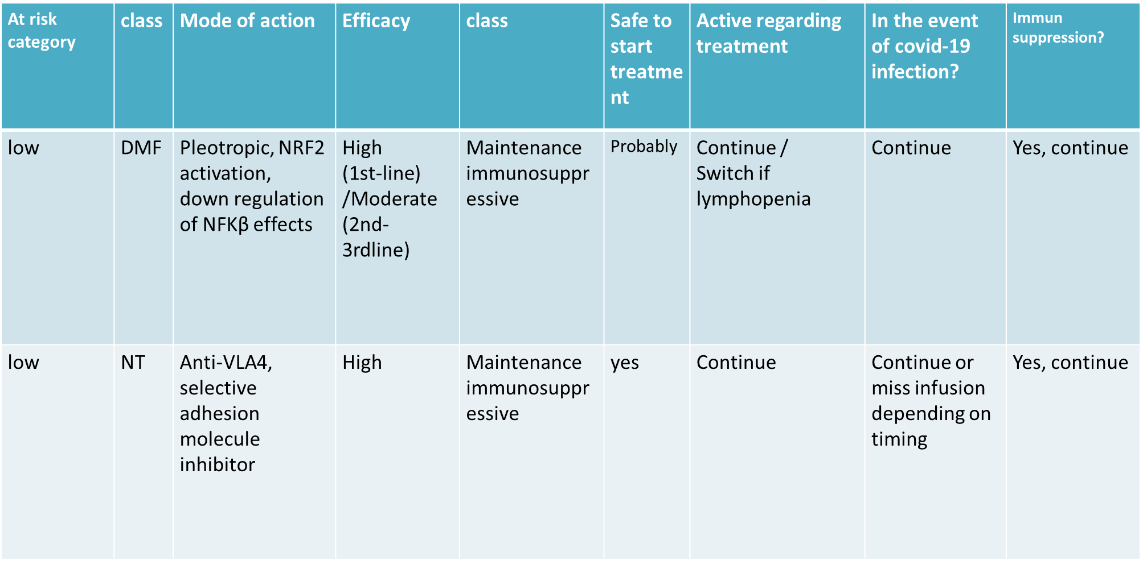

Slide 17
class | Attributes and caveats
DMF | The risk can only be considered low in patients who don't develop a persistent lymphopenia. Patients with a total lymphocyte count of less than 800/mm3 should be considered be at a higher risk of developing complications from COVID19 infection.
NT | Low risk, but theoretical concerns of creating an environment in mucosal surfaces and the gut that may promote prolonged viral shedding.

Slide 18
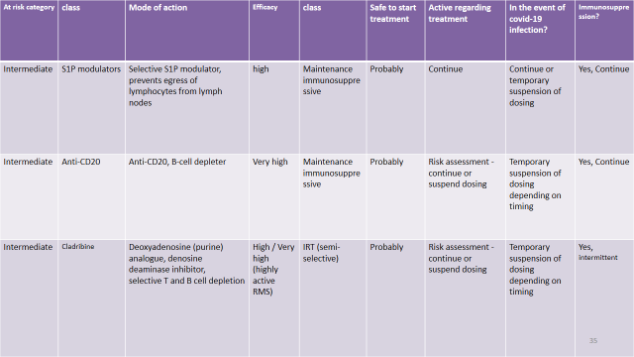

Slide 20
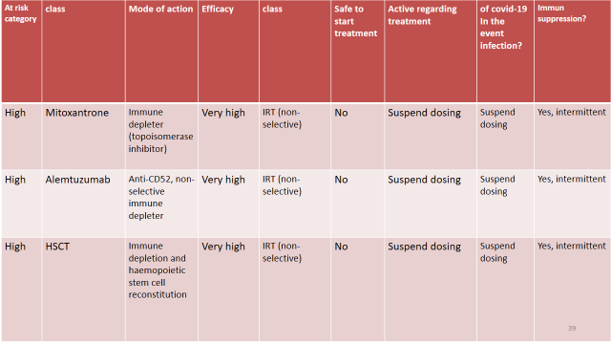

Slide 22
Treatment of MS patients
Given the lack of knowledge or data on the COVID-19 disease course in MS patients receiving DMTs, at present there is no recommendation to stop the different DMTs and therefore expose MS patients to the risk of MS exacerbations.
We, therefore, recommend continuing the current DMT specifically with:
- First-line DMTs (beta-interferons, glatiramer acetate, teriflunomide or dimethyl fumaratecan be prescribed as usual
- Fingolimod
- Natalizumab

Slide 23
For ‘lymphodepleting’ DMTs: Any decisions about these DMTS should be based on individual circumstances
Temporarily delay the start of lymphodepleting DMTs such as ocrelizumab, alemtuzumab, rituximab or cladribine.
Temporarily delay (between 6 and 12 months depending on the DMT)
Re-dosing of alemtuzumab, ocrelizumab and cladribine.
This decision should be made according to individual factors such as disease severity and activity.
Delay the next dose even beyond 6 months if CD19+ and CD20+ lymphocyte counts are severely decreased

Slide 24
Special considerations
for patients who have already received the first dose of the first cycle, it is recommended to give the second dose and ‘extra precautions’ should be taken.
Patients with confirmed COVID-19 infection: Withhold any first or second-line DMT until clinical resolution and/or approval to continue treatment by an infectious disease specialist

Slide 25
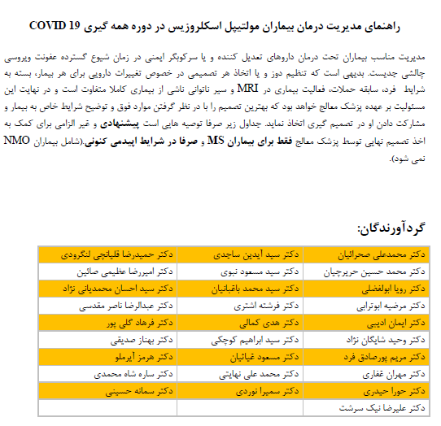

Slide 27
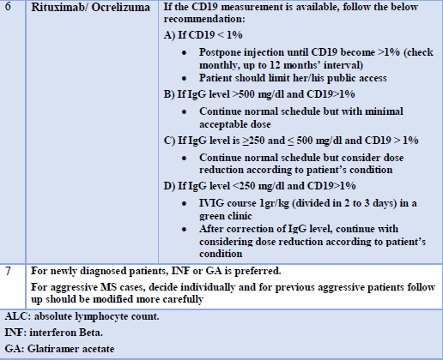

Slide 30
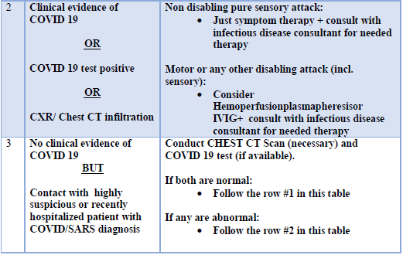

Slide 31
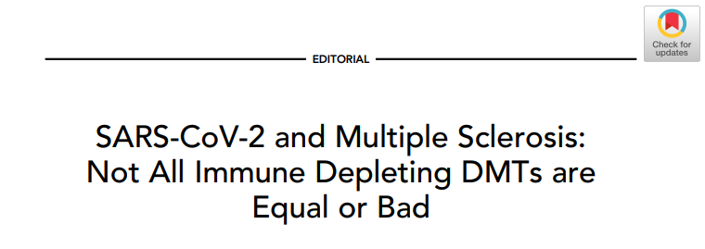

Slide 32
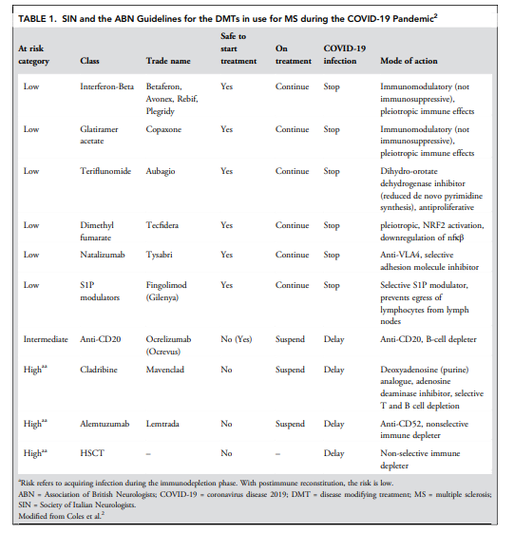

Slide 33
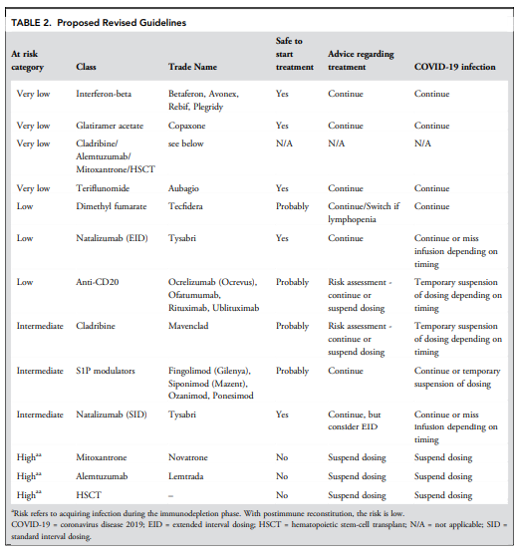

Slide 34
MSIF Update last Advice
Interferons (Avonex, Betaseron, Extavia, Plegridy, Rebif) and glatiramer acetate (Copaxone) are unlikely to impact negatively on COVID-19 severity. There is some preliminary evidence that interferons may reduce the need for hospitalization due to COVID-19.
The evidence available suggests that people with MS taking dimethyl fumarate (Tecfidera), diroximel fumarate (Vumerity), teriflunomide (Aubagio), fingolimod (Gilenya), natalizumab (Tysabri), ozanimod (Zeposia) and siponimod (Mayzent) do not have an increased risk of more severe COVID-19 symptoms.
There is some evidence that therapies that target CD20 – ocrelizumab (Ocrevus) and rituximab (Rituxan)– may be linked to an increased chance of having a more severe form of COVID-19. However, these therapies should still be considered as an option for treating MS during the pandemic. People with MS who are taking them or ofatumumab (Kesimpta) that works in the same way, should be particularly vigilant regarding the advice here to reduce their risk of infection.
More data on the use of alemtuzumab (Lemtrada) and cladribine (Mavenclad) during the COVID-19 pandemic are required to make any assessment of their safety. People with MS who are currently taking these therapies and are living in a community with a COVID-19 outbreak should discuss their current lymphocyte counts with their healthcare professional. (Lymphocytes are a type of white blood cell that helps protect the body from infection). If their counts are considered to be low they should isolate as much as possible to reduce their risk.
Recommendations on delaying second or further doses of alemtuzumab, cladribine, ocrelizumab and rituximab due to the COVID-19 outbreak differ between countries. People who take these medications and are due for the next dose should consult their healthcare professional about the risks and benefits of postponing treatment. People are strongly encouraged not to stop treatment without the advice of their clinician.

Slide 36
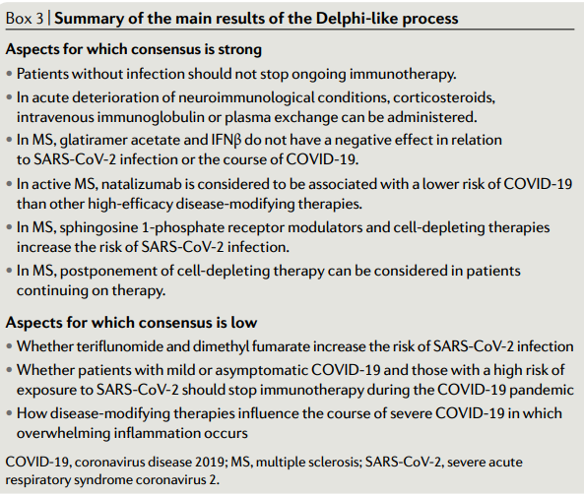

Slide 37
COVID-19 Vaccines
An Emergency Use Authorization (EUA) is a mechanism to facilitate the availability and use of medical countermeasures, including vaccines, during public health emergencies, such as the current COVID-19 pandemic.
Under an EUA, FDA may allow the use of unapproved medical products, or unapproved uses of approved medical products in an emergency to diagnose, treat, or prevent serious or life-threatening diseases or conditions.

Slide 38
COVID-19 Vaccines
From a safety perspective, FDA expects an EUA submission will include all safety data accumulated from phase 1 and 2 studies conducted with the vaccine, with an expectation that phase 3 data will include a median follow-up of at least 2-months (meaning that at least half of vaccine recipients in phase 3 clinical trials have at least 2 months of follow-up) after completion of the full vaccination regimen.
Researchers are currently testing 69 vaccines in clinical trials on humans, and 20 have reached the final stages of testing. At least 89 preclinical vaccines are under active investigation in animals.

Slide 40
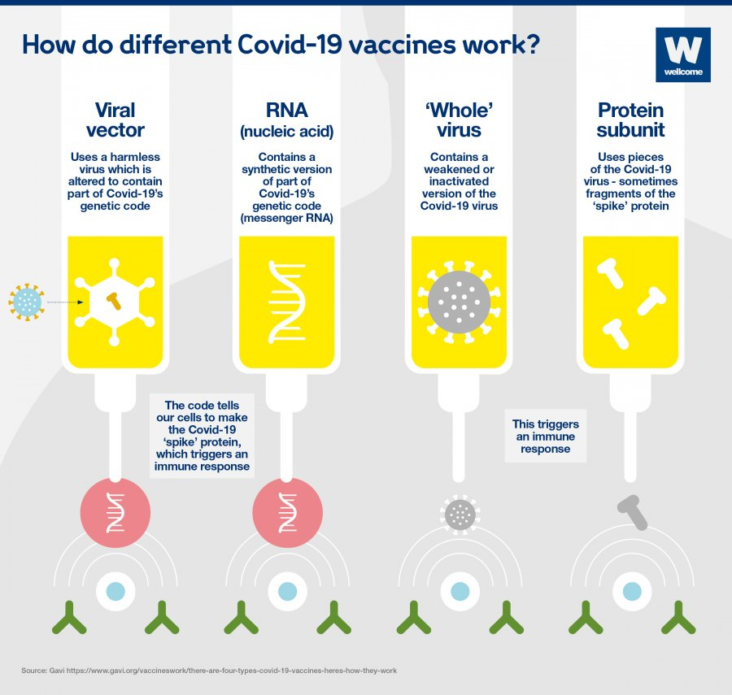

Slide 43
Viral-vector vaccines
Scientists began creating viral vectors in the 1970s. Besides being used in vaccines, viral vectors have also been studied for gene therapy, to treat cancer, and for molecular biology research.
Strong immune response
Immune response involves B cells and T cells
Previous exposure to the vector could reduce effectiveness
Relatively complex to manufacture

Slide 44
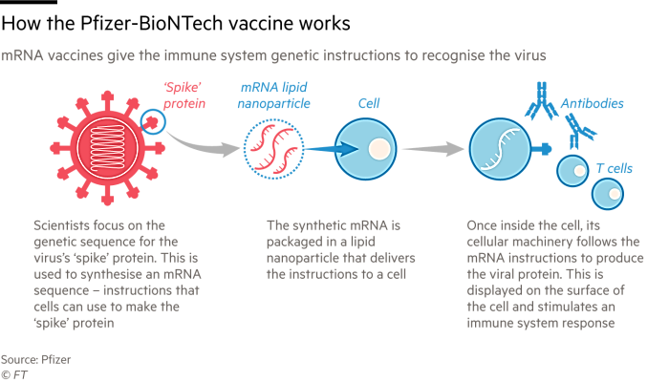

Slide 45
Include good safety (since there are no live components, there’s no risk of the vaccine triggering disease),
reliability,
that it’s relatively simple to manufacture.
Unintended effects (such as an unintended immune reaction),
Ensuring effective delivery into the body (since free RNA in the body is quickly broken down),
storage issues,
Booster shots may be required
Plus the fact that this type of vaccine has never previously been licensed for humans.

Slide 46
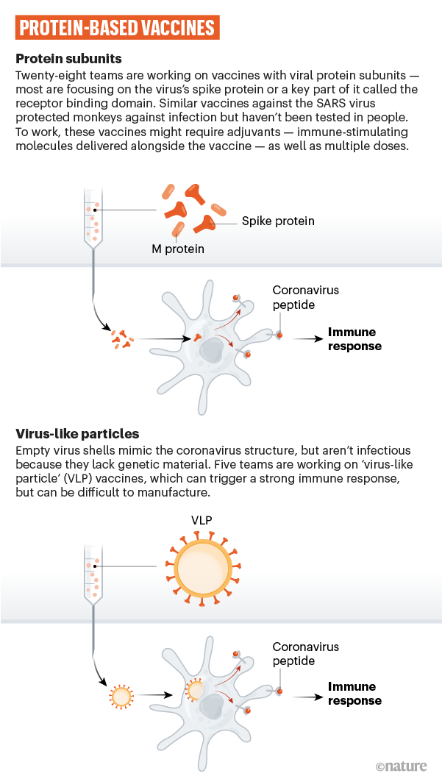

Slide 48
Virus Protein Vaccines
Well-established technology
Suitable for people with compromised immune systems
No live components, so no risk of the vaccine triggering disease
Relatively stable
Relatively complex to manufacture
Adjuvants and booster shots may be required
Determining the best antigen combination takes time

Slide 49
Inactivated virus vaccines
Inactivated virus vaccines also contain the disease-causing virus, or parts of it, but their genetic material has been destroyed. For this reason, they are considered safer and more stable than live attenuated vaccines, and they can be given to people with compromised immune systems.
Even though their genetic material has been destroyed, inactivated viruses usually contain many proteins which the immune system can react to. But because they cannot infect cells, inactivated vaccines only stimulate antibody-mediated responses, and this response may be weaker and less long-lived.
its technology is well established, it is suitable for people with compromised immune systems, and it’s relatively simple to manufacture.
Booster shots may be required.

Slide 51
COVID Vaccines and disease-modifying therapies
Inactivated vaccines should ideally be given at least 2 weeks before starting maintenance immunosuppressive and IRTs
Live attenuated virus vaccines such as MMR, varicella-zoster virus (VZV) and yellow fever vaccines are generally not recommended in people with MS during and shortly (<4-6 weeks) before maintenanceimmunosuppressive and IRTs

Slide 52
COVID Vaccines and disease-modifying therapies
Interferons
Vaccination : Safe and effective
Glatiramer acetate
Vaccination : Safe. Inactivated influenza vaccine may be less effective
Teriflunomide
Inactivated neoantigens (first vaccination) and recall antigens (re-exposure) have been found to be safe and effective
Live-attenuated vaccines should be avoided during treatment and for 6 months after stopping

Slide 53
COVID Vaccines and disease-modifying therapies
Dimethyl fumarate
Inactivated neoantigens and recall antigens have been found to be safe and effective
Live-attenuated vaccines should be avoided until lymphocyte counts have returned to above 800/mm3 after stopping treatment
Fingolimod
During—and for up to 2 months after treatment,
✓Inactivated vaccines may be less effective.
✓Live-attenuated vaccines should be avoided

Slide 54
COVID Vaccines and disease-modifying therapies
Natalizumab
Inactivated neoantigens and recall antigens , immune responses have been found to be preserved, some studies have suggested that inactivated influenza vaccine may be less effective.
Live-attenuated vaccines have not been studied and should be avoided (in particular neurotropic viruses)

Slide 55
COVID Vaccines and disease-modifying therapies
Ocrelizumab/ Rituximab
Non-live vaccines may be less effective.
Live-attenuated vaccines have not been studied and should, therefore, be avoided during treatment and after discontinuation until B-cell repletion
For B cell -depleting therapy and both B- and T depleting treatment, it is suggested to wait until Bcells have returned to normal levels and no earlier than 6 months for rituximab

Slide 56
Corticosteroids
➢ >40 mg/ day of prednisone or equivalent for ≥7 consecutive days
➢ >20 mg/day of prednisone or equivalent for ≥14 consecutive days
Inactivated vaccines: 4 weeks after the last dose of steroids (Riva A, et al. 2020)
2. Live attenuated vaccines:
• 3 months after the last dose of steroids
• At least 4 weeks after discontinuing high-dose corticosteroids

Slide 57
Thanks for Your Attention

